Slide 1
SALES OPERATIONS | H1 2026 PROJECT SUBMISSION
Sales Revenue Tracker System
An end-to-end Excel-based system to log, monitor, and report sales revenue — built for real-time visibility and faster decisions.
Prepared for: Sales Manager
Prepared by: Sales Operations Team
Date: 3 July 2026
Notes:
Good morning/afternoon. Today I'm presenting the Sales Revenue Tracker System -- a project we built to fix how our team logs and reports sales revenue. This is ready for review and rollout.

Slide 2
What This Deck Covers
01
Business Problem & Objective
05
Dashboard Preview
Why the team needed a structured revenue tracker
A look at the live executive dashboard
02
Solution Overview
06
Performance Insights
What the system does and who it's for
Regional, category and rep-level breakdowns
03
How It Works
07
Business Impact & Next Steps
Data flow from entry to executive dashboard
Value delivered and the roadmap ahead
04
Key Features
Automation, KPIs, and reporting built in
Sales Revenue Tracker System
2
Notes:
Here's what I'll walk through: the problem we were solving, how the solution works end-to-end, its key features, a live look at the dashboard, the insights it already surfaces from our H1 data, and where we'd take it next.

Slide 3



The Problem
Slow reporting
Sales data was scattered across personal spreadsheets and WhatsApp updates. The manager had no single source of truth for monthly revenue, and reports took hours to compile by hand before every review.
Manual compilation took 3-4 hours every week before each review meeting.
No visibility
No single view of revenue by region, category, or sales rep.
Objective
Error-prone
Build one structured Excel workbook where the team logs sales once, and revenue, profit, and performance reporting update automatically for the manager.
Copy-paste totals across sheets led to mismatched numbers.
Sales Revenue Tracker System
3
Notes:
Until now, sales data lived in personal spreadsheets and WhatsApp updates. That meant no single source of truth, reports that took 3-4 hours to compile every week, and numbers that didn't always match when copy-pasted across sheets. Our objective was simple: one workbook, where the team logs a sale once, and every report updates itself.

Slide 4




Solution Overview
A single Excel workbook — the Sales Revenue Tracker — replaces scattered spreadsheets with one connected system covering data entry, calculation, and reporting.
1. Log
2. Calculate
3. Summarize
4. Report
Team enters every sale once in the Sales_Data sheet — date, region, rep, product, units, price.
>
Revenue, cost, profit and margin are computed automatically with built-in formulas.
>
Five summary sheets roll data up by month, region, category and rep — instantly.
>
The executive Dashboard gives the manager a one-page view with KPIs and charts.
Sales Revenue Tracker System
4
Notes:
The system works in four steps -- Log, Calculate, Summarize, Report. The team logs a sale in one sheet. Formulas calculate revenue, cost, and profit automatically. Five summary sheets roll that up by month, region, category, and rep. And all of it feeds a single executive dashboard.

Slide 5





How It Works — Data Flow
One entry point feeds every report in the workbook — no duplicate data entry, no manual totals.
Sales_Data
>
Auto-Calculation
>
Summary Sheets
>
Executive Dashboard
Team logs each sale: date, rep, region, product, units, price
Formulas compute Revenue, Cost, Profit and Margin % for every row
Monthly, Regional, Category and Rep views roll up instantly via SUMIF
Manager sees KPIs and charts on one page — always current
Always in sync: Because every report is formula-linked to Sales_Data, adding one new row updates the Dashboard, all summaries, and the Target tracker at the same time — no manual refresh, no re-typing totals.
Sales Revenue Tracker System
5
Notes:
This is the data flow. Sales_Data is the only place anyone types a new sale. From there, formulas calculate everything, summary sheets roll it up instantly, and the dashboard reflects it in real time. Because it's all formula-linked, there's no manual refresh and no re-typing totals -- add one row, and everything updates.

Slide 6





Key Features
Centralized Data
Live KPI Dashboard
Regional Breakdown
One structured table is the single source of truth for every sale.
Revenue, profit, margin, orders and AOV update the instant data changes.
Revenue and profit split by North, South, East and West.
Category Analysis
Rep Scorecards
Target Tracking
Performance by product category — Electronics, Furniture, Software and more.
Ranked leaderboard of sales reps by revenue and average deal size.
Monthly targets vs. actuals with automatic achievement status flags.
Sales Revenue Tracker System
6
Notes:
Six things this system gives us that we didn't have before: centralized data, a live KPI dashboard, regional and category breakdowns, ranked rep scorecards, category analysis, and automatic target tracking.

Slide 7

Data Captured Per Sale
Every transaction logged in Sales_Data carries 15 fields — 9 entered by the team, 6 calculated automatically.
Field | Type | Description
Sale ID, Date, Region, Sales Rep | Entered | Identifies who sold what, where, and when
Category, Product, Customer Type | Entered | Describes what was sold and to whom
Units Sold, Unit Price, Unit Cost | Entered | The raw numbers behind each transaction
Revenue, Cost, Profit, Margin % | Auto-calculated | Computed instantly by formula — never typed manually
Month | Auto-calculated | Extracted from Date to power monthly roll-ups
The team only ever types into the blue-colored input cells — everything else is formula-driven and protected from accidental edits.
Sales Revenue Tracker System
7
Notes:
Each sale captures 15 fields -- 9 that the team types in, like date, region, and price, and 6 that calculate automatically, like revenue and margin. We've color-coded the workbook so the team only ever edits the blue input cells -- everything else is protected formula logic.

Slide 8
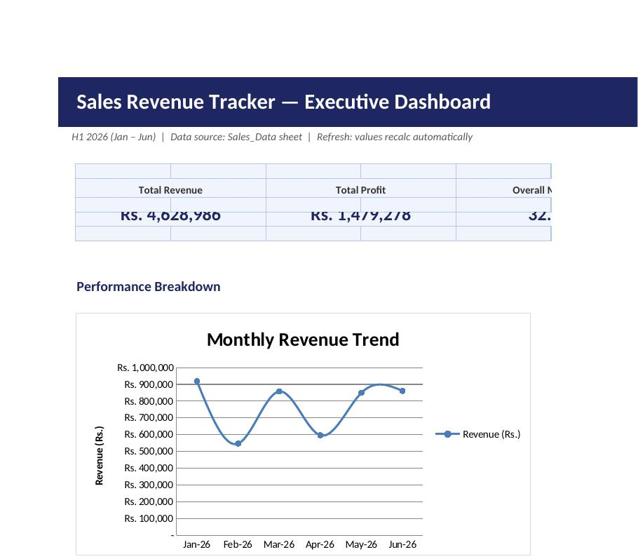
Dashboard Preview
Live view from the Dashboard tab of Sales_Revenue_Tracker.xlsx
Total Revenue
₹46.3L
Overall Margin
31.9%
Total Orders
220
Sales Revenue Tracker System
8
Notes:
This is the actual dashboard, live from the workbook. Total revenue, profit margin, and order count update automatically. For H1 2026 so far, we're at Rs. 46.3 lakh in revenue at a 31.9% margin across 220 orders.

Slide 9
Performance Insights — H1 2026
What the data tells us
Revenue held steady through H1, dipping slightly in Q2 before recovering to a June high.
South and West lead regional revenue; North has the most headroom to grow.
Software is the top-earning category despite fewer orders — high average deal size.
Office Supplies contributes the most orders but the smallest revenue share.
Sales Revenue Tracker System
9
Notes:
A few things the data already tells us: revenue held steady through H1 with a dip in Q2 before recovering in June. South and West are our strongest regions. Software is our top-earning category despite fewer orders -- it has the highest average deal size. And Office Supplies drives the most orders but the smallest revenue share.

Slide 10


Business Impact
What changes for the team and the manager once this system is in use.
BEFORE
AFTER
3-4 hours spent compiling weekly reports by hand
Reports are always current — zero manual compilation
No consistent view of revenue by region or rep
One dashboard shows region, category and rep performance
Numbers often mismatched across personal sheets
Single source of truth — every number traces to one row
Manager reviews performance after the fact
Manager tracks targets vs. actuals in real time
Sales Revenue Tracker System
10
Notes:
Here's the before and after. We've gone from hours of manual compilation to zero -- reports are always current. We've gone from no regional visibility to one dashboard showing everything. And we've gone from mismatched numbers to one source of truth that every number traces back to.

Slide 11
Roadmap & Next Steps
Phase 1 — Now
Phase 2 — 30 Days
Phase 3 — 90 Days
Phase 4 — Later
Rollout
Refine
Extend
Automate
Team adopts Sales_Data as the single entry point; manager reviews the Dashboard weekly.
Add data validation dropdowns and lock formula cells to prevent accidental edits.
Introduce customer-level tracking and a quarterly forecast sheet.
Explore Power Query / API links to remove manual data entry entirely.
Sales Revenue Tracker System
11
Notes:
This is phase one -- team adoption starting now. Over the next 30 days we'll add data validation and lock the formula cells. In 90 days, we'd like to add customer-level tracking and quarterly forecasting. Longer term, we can explore automating data entry entirely.

Slide 12
Thank You
Questions & feedback welcome — the workbook and this deck are ready for review.
Sales Operations Team
Sales_Revenue_Tracker.xlsx | Sales_Revenue_Tracker.pptx
3 July 2026
Notes:
That's the system. The workbook and this deck are both ready for your review -- happy to walk through the sheet in more detail or take any questions.

